Slide 1
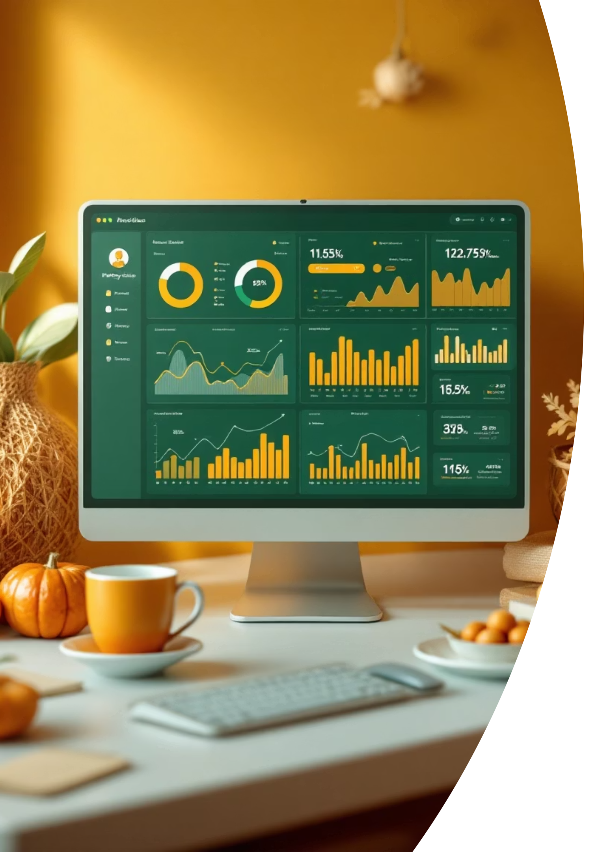
Customer Shopping Behavior Analysis
Uncovering insights from 3,900 purchases across multiple product categories

Slide 2


Project Scope
Objective
Dataset
Analyze customer shopping behavior and spending patterns
3,900 transactions across 18 data columns
Focus Areas
Customer segments, product preferences, subscription behavior

Slide 3
Dataset Deep Dive
Customer Insights
Transaction Details
Age, Gender, Location
Item & Category
Subscription Status
Purchase Amount
Previous Purchases
Season, Size, Color
Frequency of Purchases
Discount & Promo Codes
3,900
18
37
Total Transactions
Data Columns
Missing Values
In Review Rating column only

Slide 4
Data Preparation Process
01
02
Data Loading
Missing Data Handling
Imported using pandas, explored with df.info() and df.describe()
Imputed Review Rating using median per category
03
04
Column Standardization
Feature Engineering
Converted to snake_case format for consistency
Added age_group and purchase_frequency_days columns
05
06
Data Cleanup
Database Integration
Removed redundant promo_code_used column
Loaded cleaned data into PostgreSQL

Slide 5
SQL Analysis Framework
1
2
3
Revenue by Gender
High-Spending Discount Users
Top 5 Products by Rating
Spending patterns across demographics
Customer satisfaction leaders
Identifying valuable discount-driven customers
4
5
Shipping Type Comparison
Subscribers vs Non-Subscribers
Delivery preference analysis
Subscription impact on behavior

Slide 6

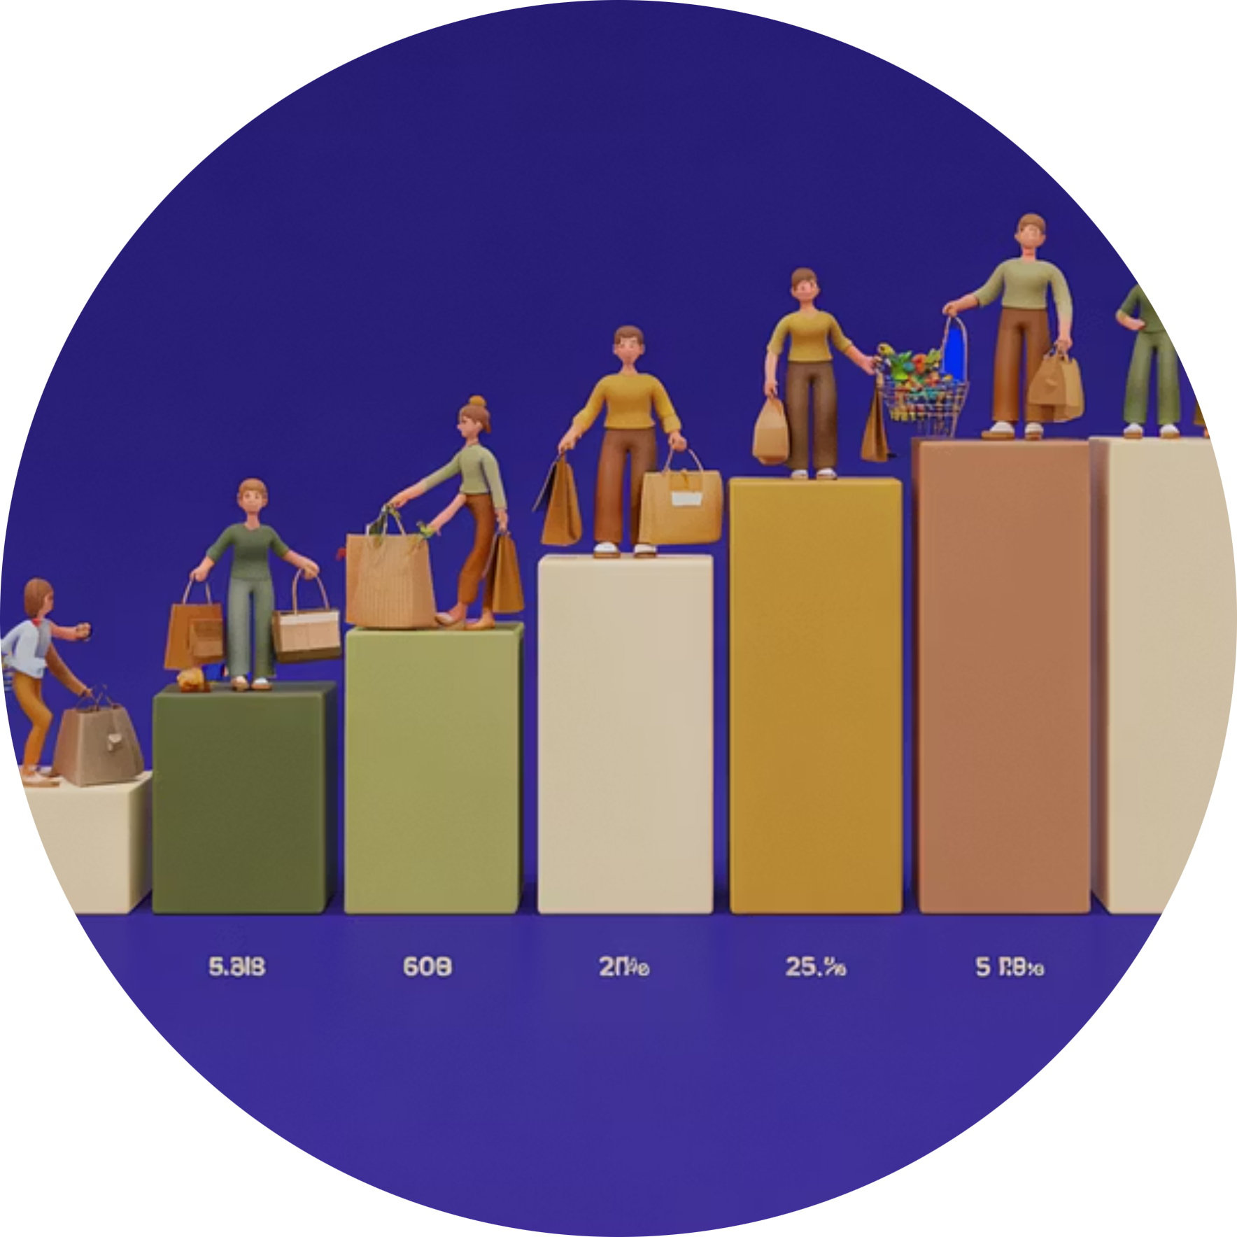
Advanced Customer Insights
Discount-Dependent Products
Customer Segmentation
Top 3 Products per Category
Items requiring promotional support
Behavioral grouping and targeting
Category-specific bestsellers
Repeat Buyers
Revenue by Age Group
Subscription correlation analysis
Generational spending patterns

Slide 7
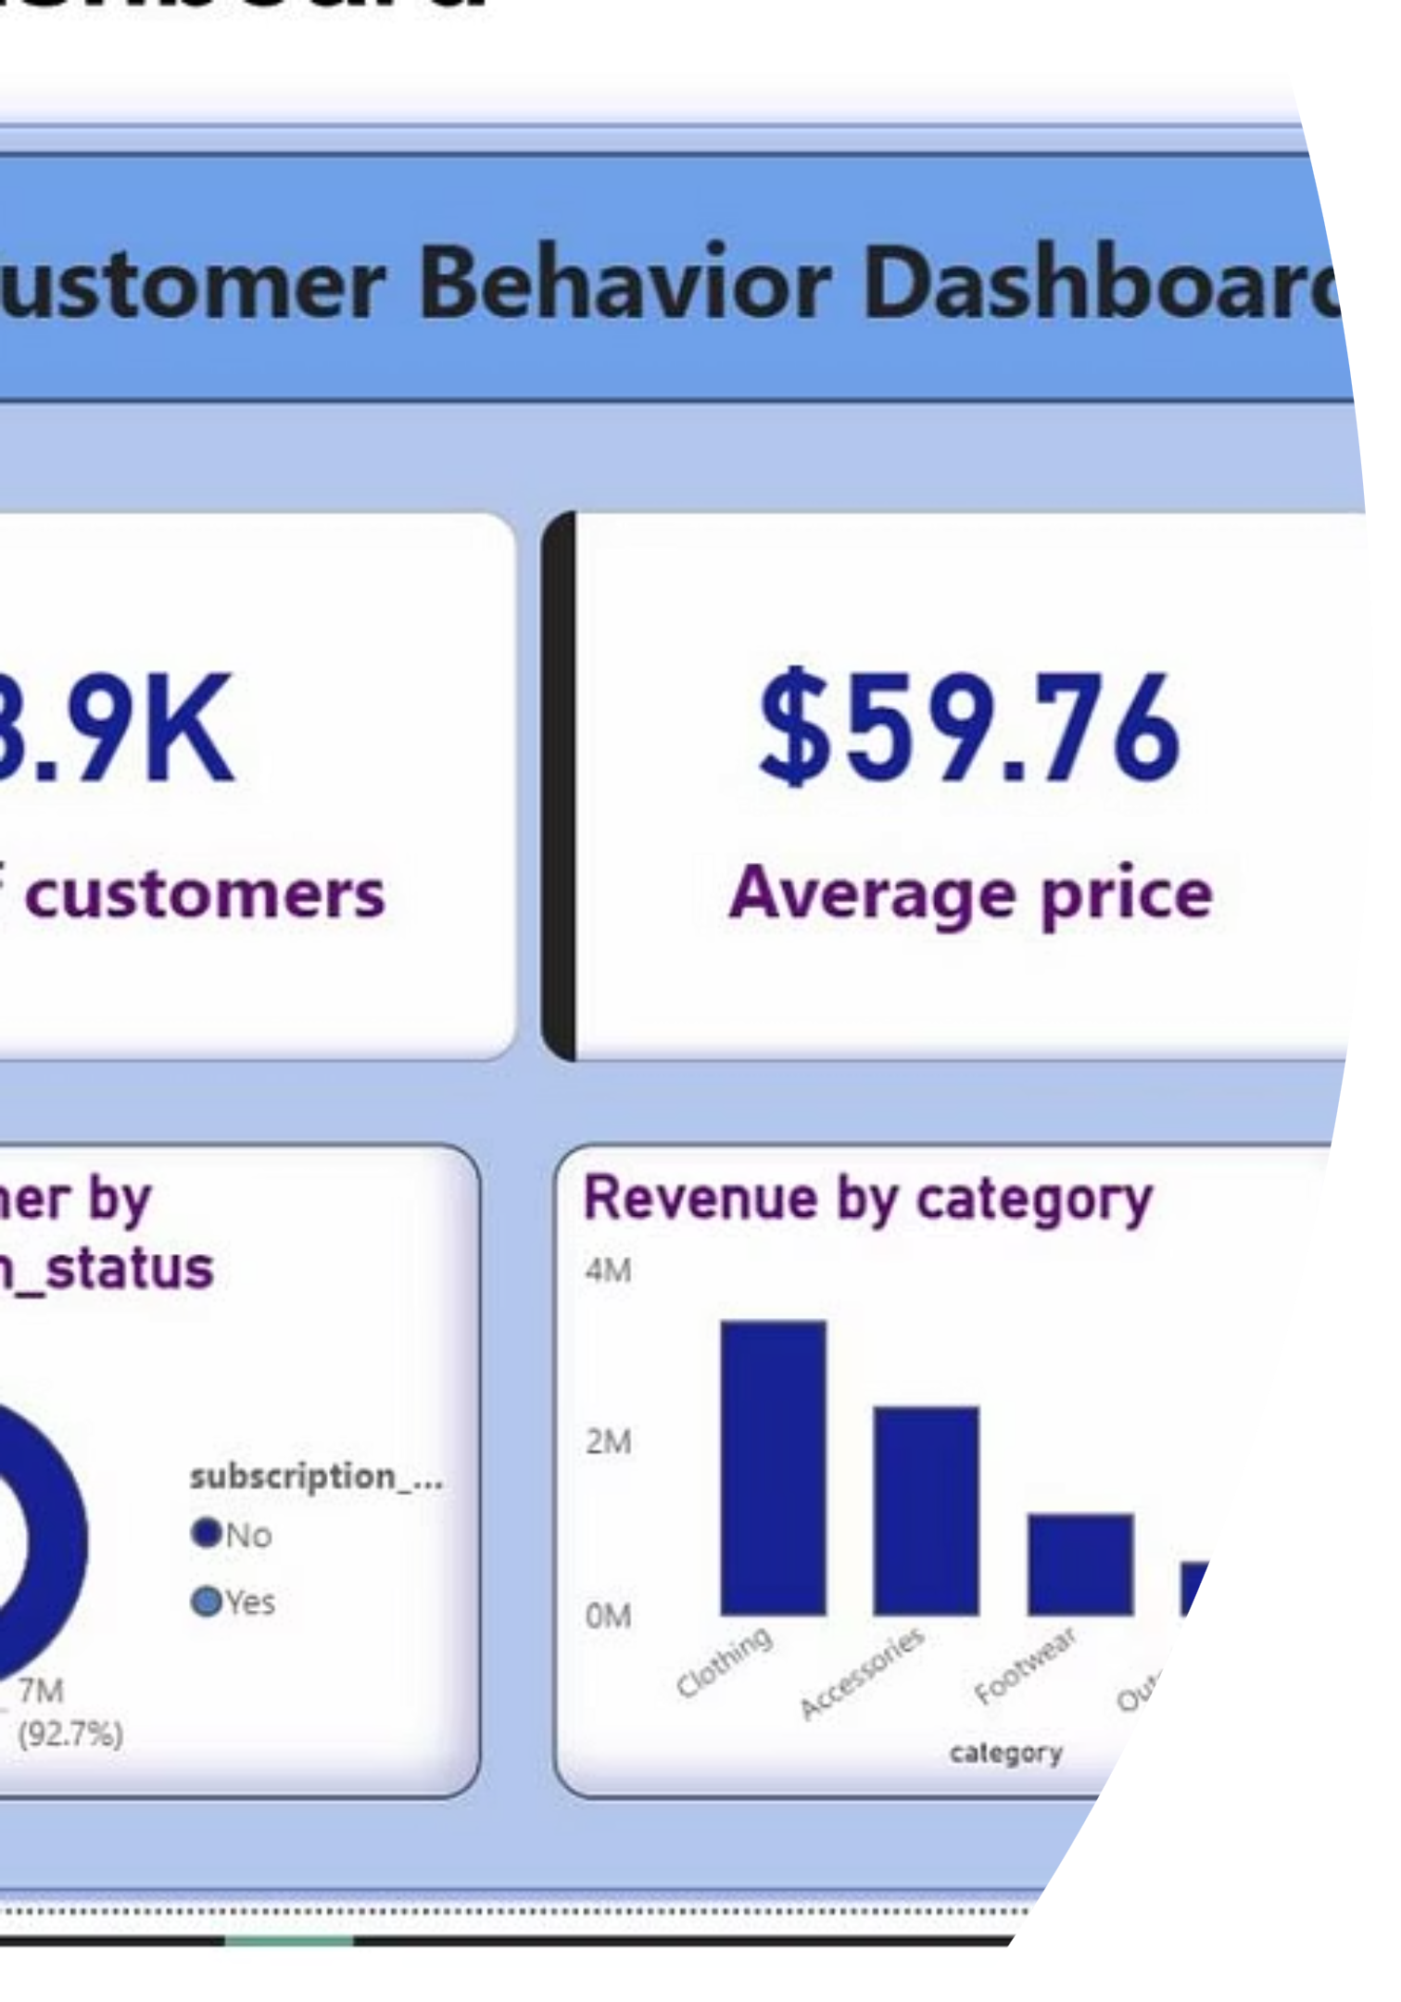
Power BI Dashboard Overview
Customer Metrics
Total customers, average purchase price, average rating
Revenue Analysis
Revenue and sales breakdown by category
Subscription Insights
Subscriber vs non-subscriber comparison

Slide 8

Key Business Recommendations

Slide 9




Strategic Action Plan
Boost Subscriptions
Promote exclusive benefits and member perks
Customer Loyalty Programs
Reward repeat buyers with incentives
Review Discount Policy
Balance profit margins with discount effectiveness

Slide 10

Growth Opportunities
Product Positioning
Targeted Marketing
Highlight top-rated and best-selling items in marketing
Focus campaigns on high-revenue age groups
Shipping Optimization
Leverage express-shipping user preferences

